Slide 1
Engaging All Rotarians
DACdb Disaster Response Module

Slide 2
Rotary is Essential in Disaster Response
VOLUNTEERS adding capacity to current response and recovery operations.
COMMUNITY CONNECTORS providing instant strategic relationships.
ESSENTIAL LEADERSHIP and professional resources.
LOGISTICS to support supply storage and distribution centers.
COMMUNITY OUTREACH using existing relationships for networking.
SUPER FUNDRAISERS supporting community organizations and initiatives.
Adapted from Rotary Zones 30 & 31 – Rotary Response Team Quick Guide

Slide 3
Working Together
It’s not “if”, but “when”, disaster will strike!
Working together throughout District 6490, we can expand our networks, our resources, our planning, and the positive impact of our actions!

Slide 4
District 6490 Disaster Response
MISSION: Provide funds, supplies and recovery operations to alleviate suffering caused by natural disasters and help communities throughout District 6490 rebuild by providing operations, funds and supplies where needed.
PURPOSE: Provide access to the information and tools necessary to allow each Club and each Rotarian in District 6490 the ability to serve, through financial/supply donations and hands-on service, during and after a disaster.
COMMITTEE MEMBERS: Marsha Bowyer (Arthur), Tonya Carter-Sanders (Rantoul), Mike Corzine (Bloomington-Normal Sunset), Janet Ellis-Nelson, DG (Champaign), Matthew Hausman (Champaign West), Tom Hodson (Champaign West), Barbara Knapp (Bloomington-Normal Daybreak), Mike Martin, DG-E (Mattoon), Ryan Mefford (Charleston), Julie Paddock (Arthur), Doc Rokosch (Danville), Jay Stortzum (Champaign), Matthew White (Champaign), Rick Wills (Bloomington-Normal Daybreak), Drake Zimmerman (Normal)
COMMITTEE CO-CHAIRS: John Calderon (Champaign), Tina Stovall (Mattoon)

Slide 5
Our Number 1 Priority for All Rotarians to Help Us Prepare
Develop a database of resources Rotarians have available that may be used in case of disaster.
All D6490 Rotarians are asked to aid in this process by entering their information in the Disaster Response Module in DACdb. The following slides will show you how!
If the inventory, skills and training you have available are needed in a future disaster response effort, we’ll contact you and help you arrange for their use. At that time, depending on the disaster need, you will be able to decide whether or not you can make your resources, and/or your time, available.

Slide 6
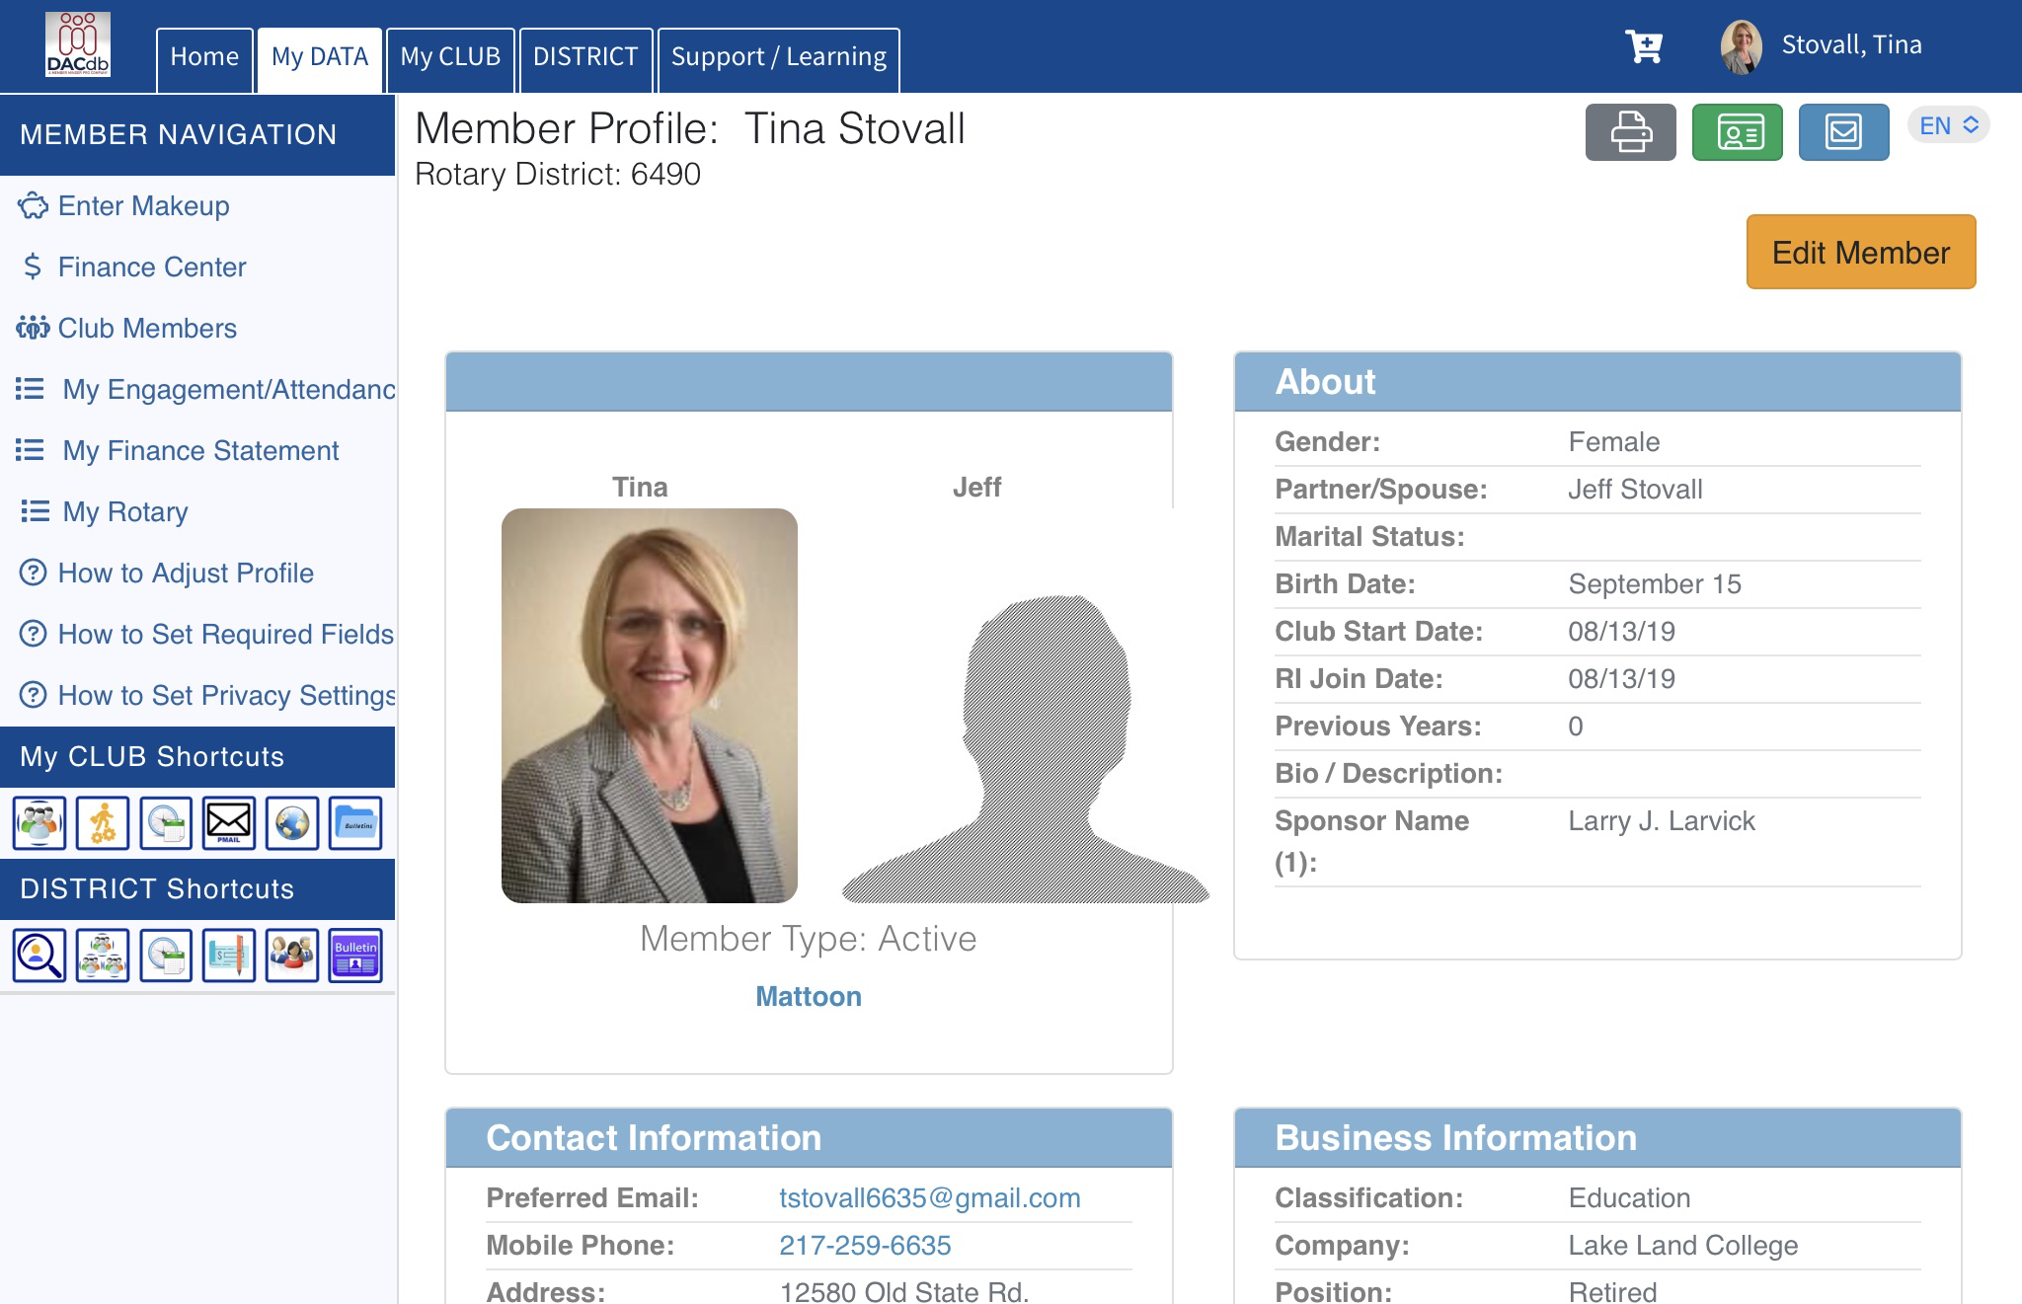
How To Complete the Disaster Response (DR) Module
Log-in to DACdb.com
Contact your Club Secretary
if you need login information
or assistance.

Slide 7
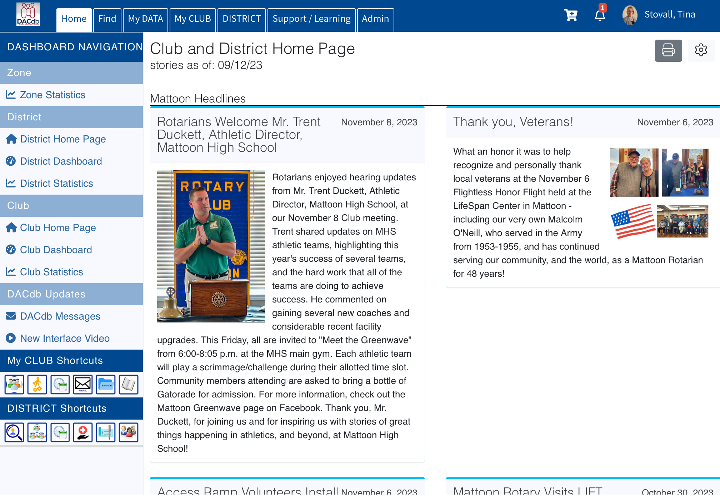
How To Complete the Disaster Response (DR) Module
Once logged in:
Select
My DATA
(top third tab from left)

Slide 8
How To Complete the Disaster Response (DR) Module
On My DATA screen:
Select
Edit Member
(far right button)

Slide 9
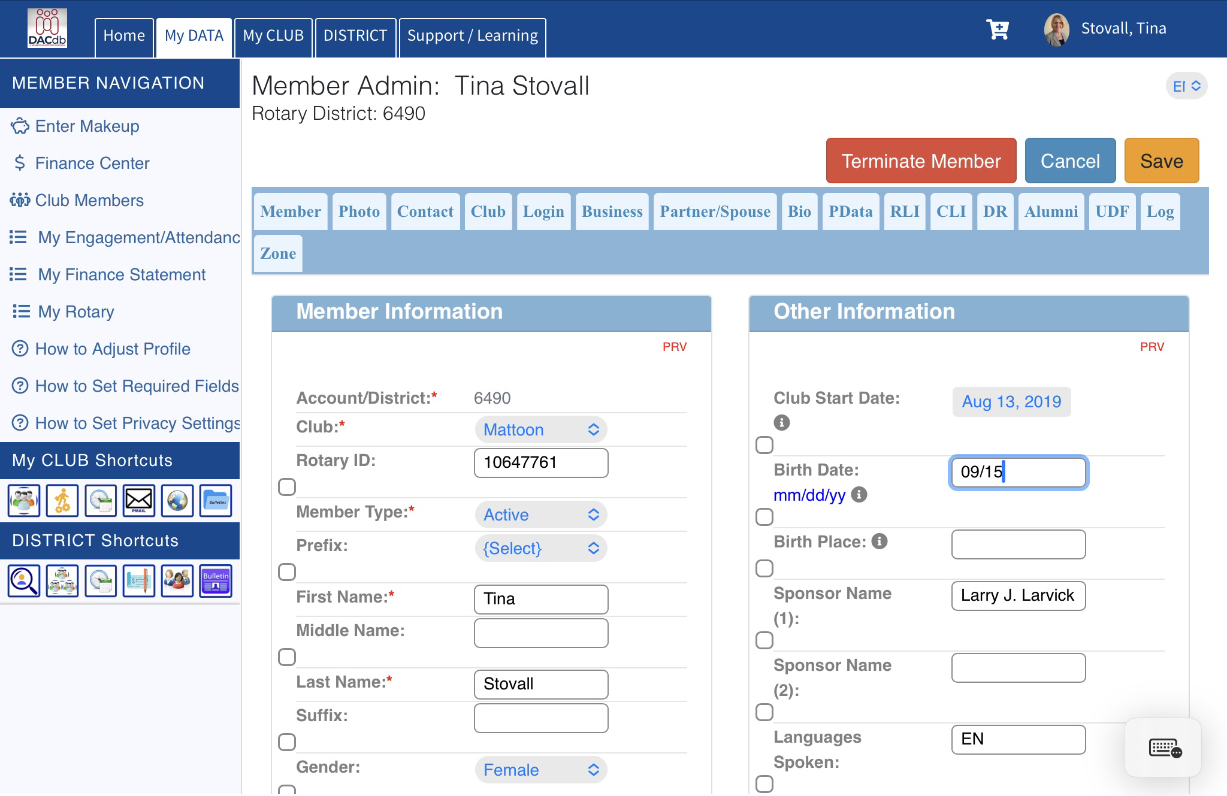
How to Complete the Disaster Response (DR) Module
On Edit Member screen:
Select
DR
(4th tab from right under Save)

Slide 10
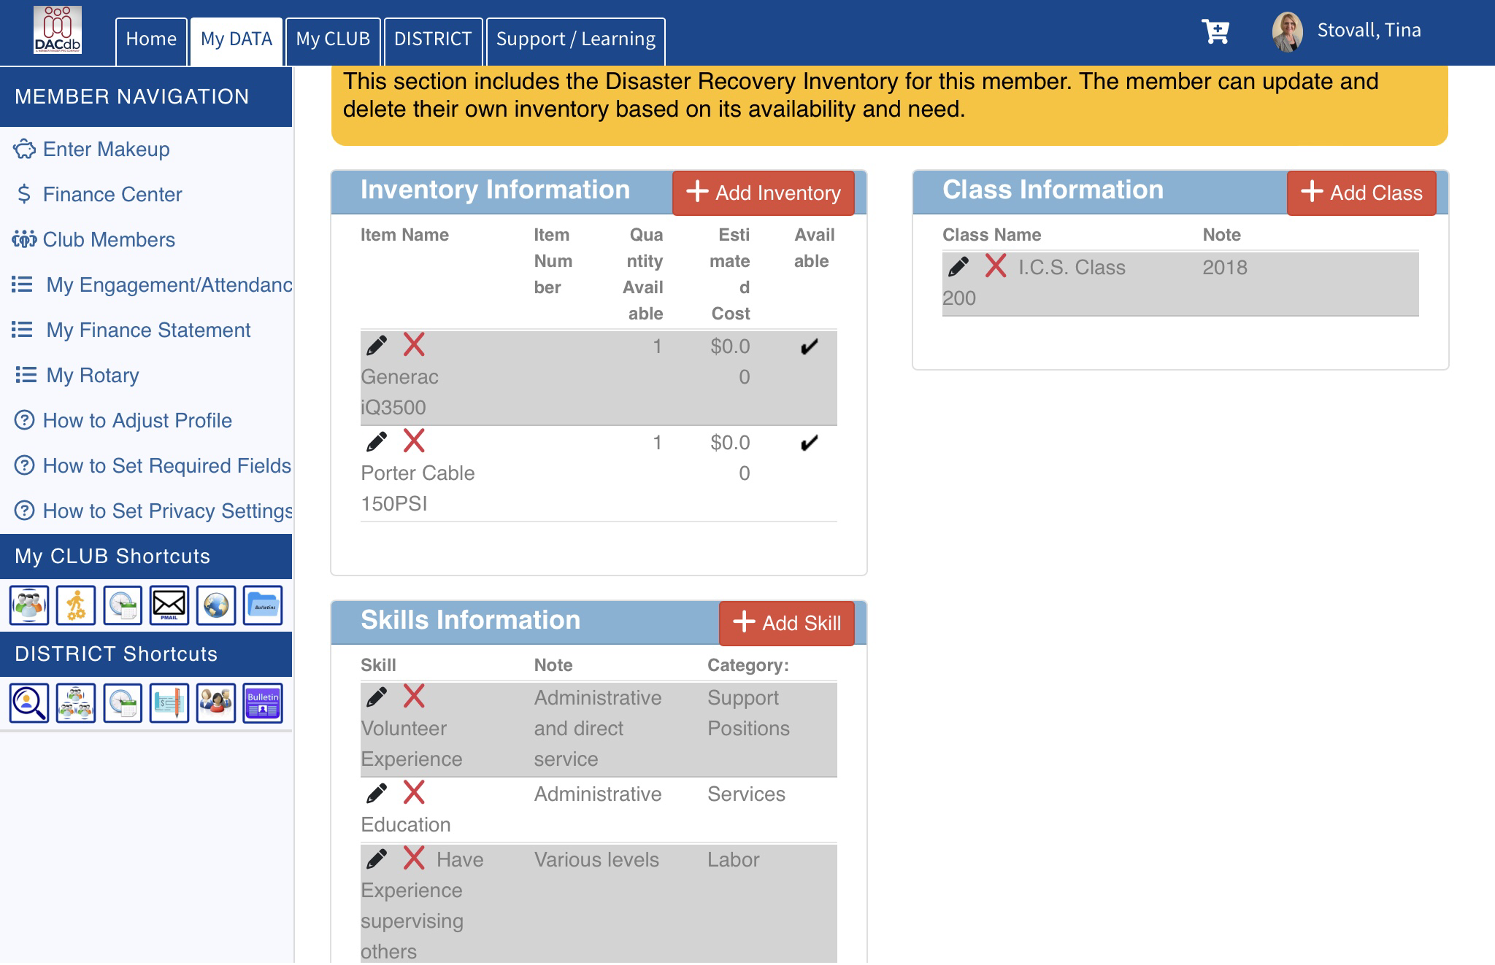
How To Complete the Disaster Response (DR) Module
On DR Screen:
+Add Inventory
(Select and Submit all that apply)
+Add Skill
(Select and Submit all that apply)
+Add Class
(Select and Submit all that apply)
BE SURE TO SAVE at end!

Slide 11
MORE WAYS TO HELP
Volunteer to coordinate efforts in working with Emergency Management Coordinators in your county, initially focusing on 01: Champaign (Champaign) 15: McLean (Bloomington) 03: Coles (Mattoon) 19: Vermillion (Danville) 12: Livingston (Dwight)
Volunteer to serve on one of the District Disaster Response Sub-Committees: Resources Charities/Finance Partnerships Grants Communications/Public Information Education On-Site Coordination/Logistics
Help develop your Club’s Disaster Response Plan. Volunteer to serve as the Disaster Response Coordinator.
Be mindful of your own personal preparedness for disaster. The better prepared we are, the more we’ll be able to help others.
Contact us to volunteer! John Calderon johnc@dndcillinois.com; 217-721-7929 Tina Stovall tstovall6635@gmail.com; 217-259-6635

